Slide 1
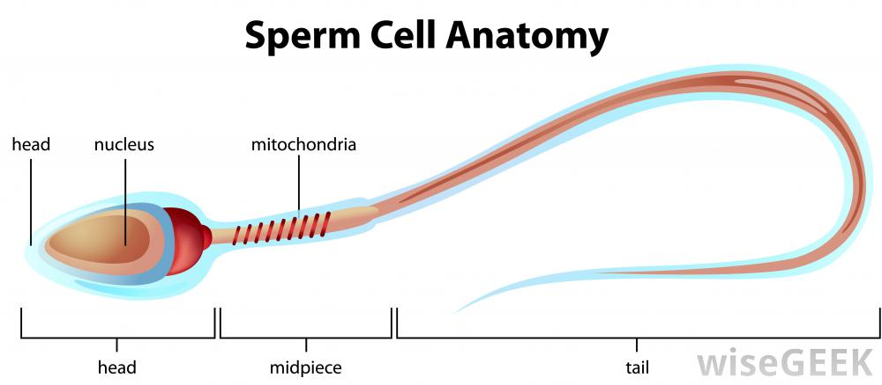

Slide 2
The sperm is small and has a longer tail so it can find the egg cells.
This purpose is to impregnate eggs.
The head contains enzymes which help allow the cell to carry out chemical reactions very fast. These reactions allow the cell to create things or put things together.

Slide 3
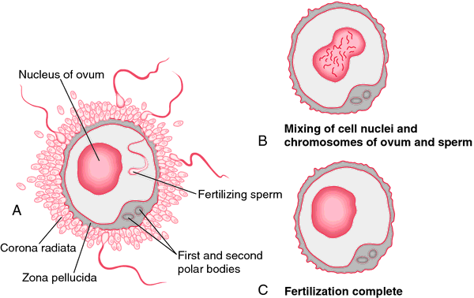
Egg (Ovum) Cell

Slide 4
Ova are made by a female's ovaries. They day of birth, a female has all of her eggs, and from puberty, she discharges an egg once a month until none are left. This is called oogenesis.
The ovum is the largest cell in the human body. You can see it without a microscope.

Slide 5
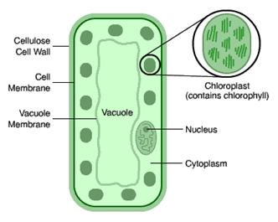
Palisade Cell

Slide 6
This is special for photosynthesis
Can be found on the top of a leaf
Their shape is really different from other cells. This cells t have many big spaces that allow the passage of gases, such as the carbon dioxide needed for photosynthesis.

Slide 7
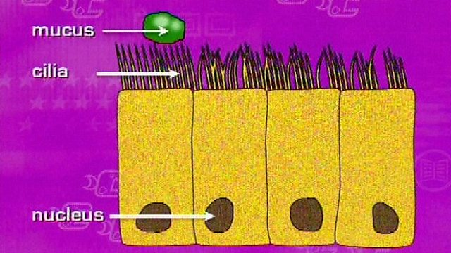
Ciliated Cells

Slide 8
This cell’s function is to stop lung damage.
They have tiny hairs that are called cilia.
They also have something called mucus that is what trappes the dust and the bacteria.

Slide 9
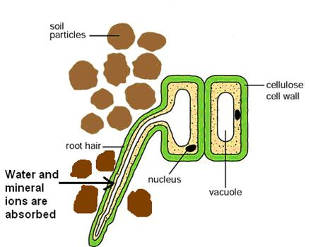
Root Hair Cell

Slide 10
This cell function is to absorb water and minerals.
It has a large surface to help absorb the water and minerals.
You can find it on a plant’s root.
The cellulose cell wall make it easier for minerals to pass.

Slide 11
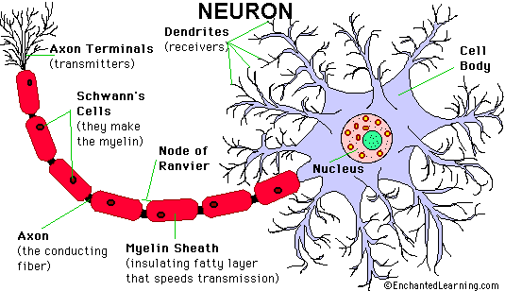

Slide 13
This is used to carry oxygen.
This can be found on your blood.
Its structure helps the oxygen way of passing
`

Slide 15
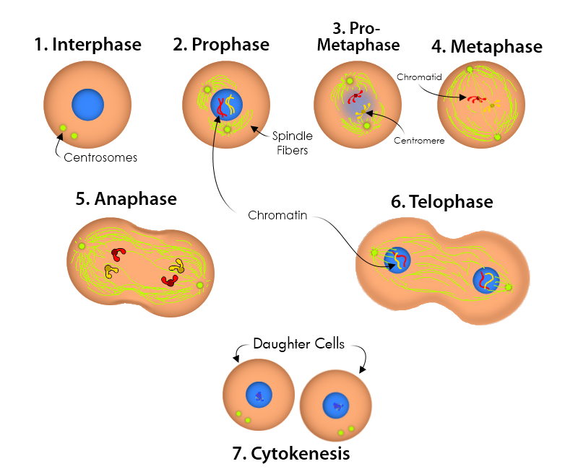
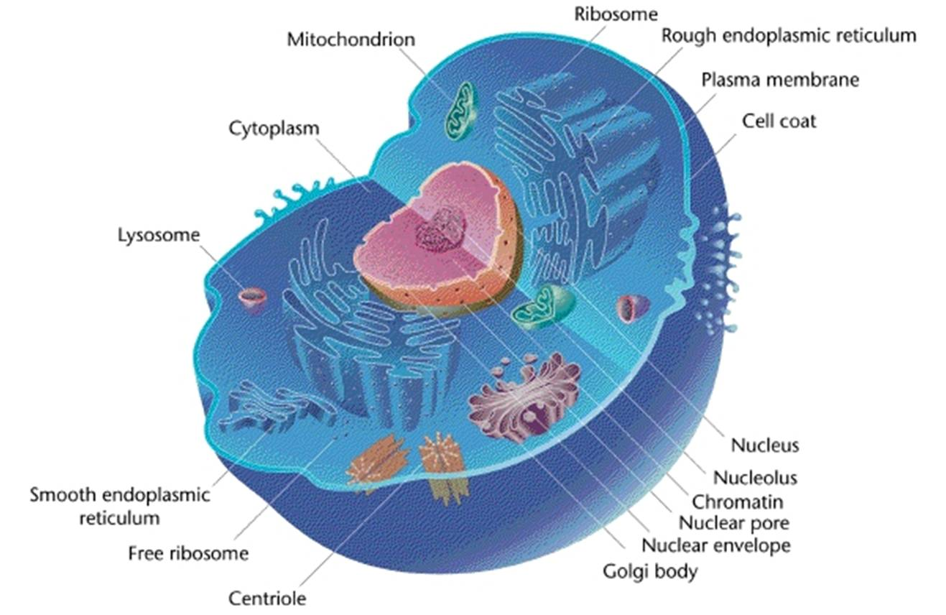
3 parts of the cell theory:
Cells are the basic structure of a living thing
All living things are made out of cells
Only existing cells can make new cells (they basically divide each other by themselves creating new ones)

Slide 16
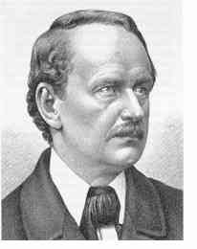
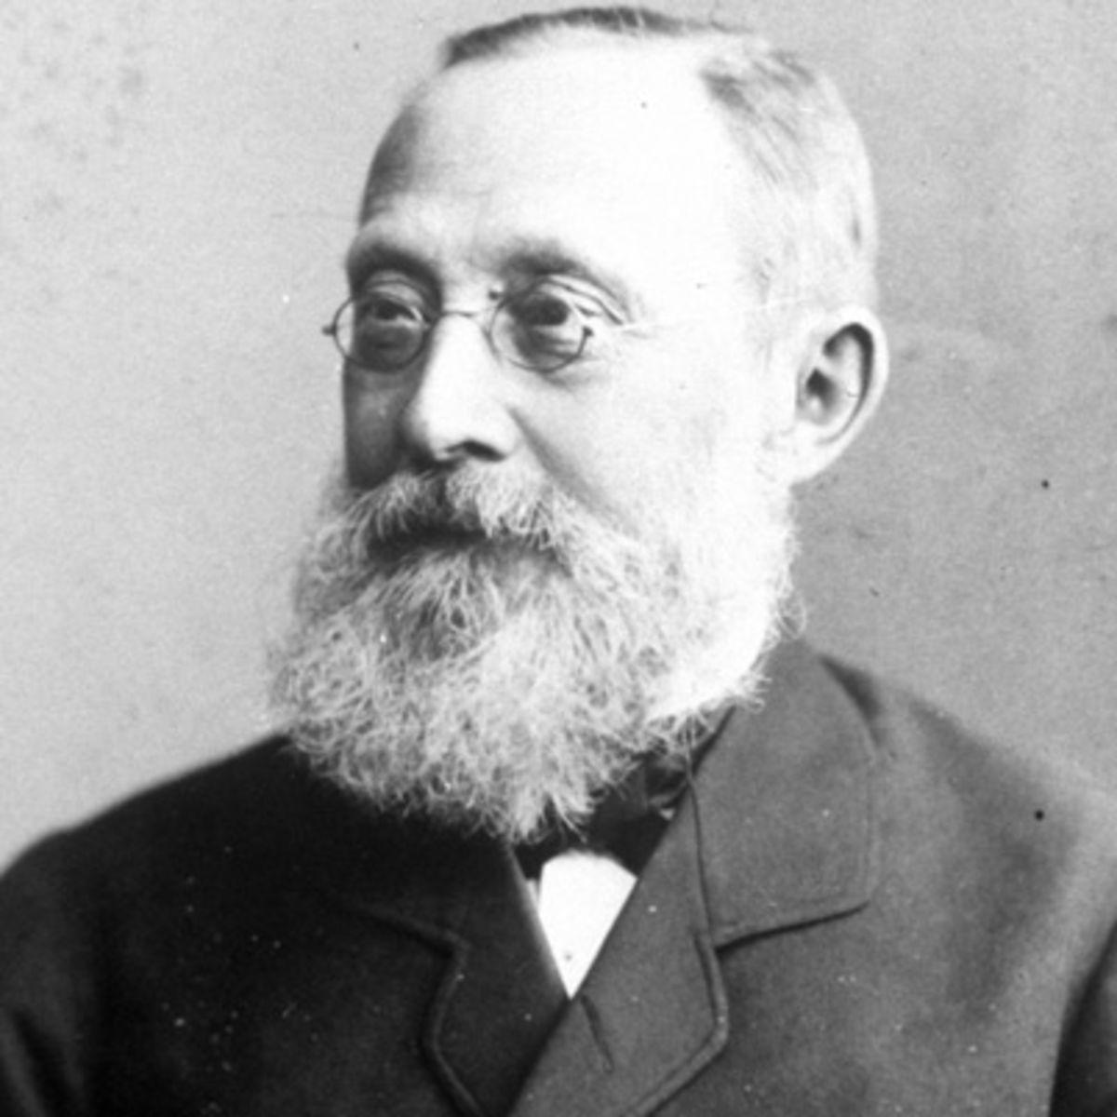
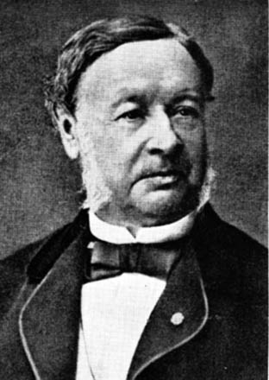
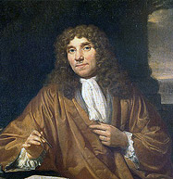
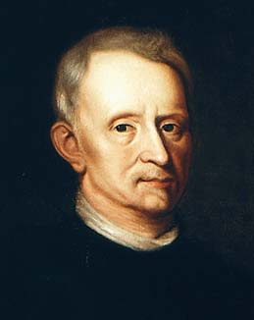
Contributors:
Schleiden
Virchow
Schwann
Leuwenhoek
Hooke

Slide 17
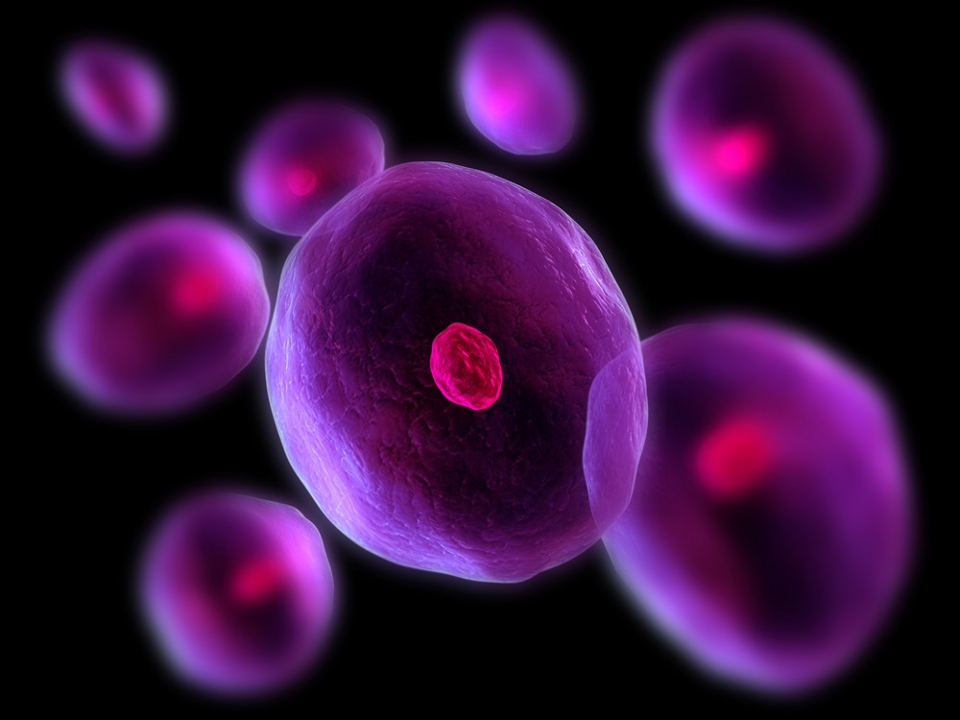
Mathias Schleiden:
He proved that the development of all plant’s tissues is created by the activity of cells.

Slide 18
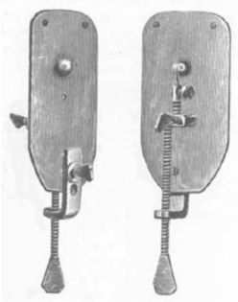
Anton van Leeuwenhoek:
He created the microscope that allowed looking at cells.

Slide 19
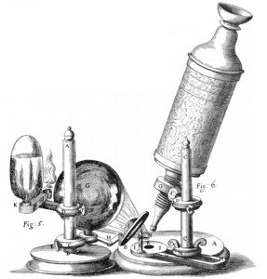
Robert Hooke:
He invented the general microscope and he discovered “the building block of life”, which then he called it “cell”.

Slide 20
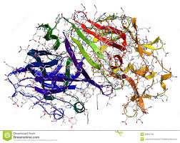
Theodor Schwann
Concluded and demonstrated that all tissues are made up of cells. Discovered the enzyme pepsin.

Slide 21
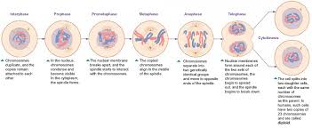
Rudolph Virchow
Created the cell theory (Built on the work of Theodor Schwann). Was one of the first to accept the current theory around the origin of cells (Division of pre-existing cells).

Slide 22
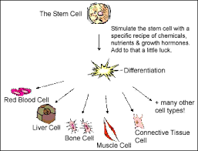
Cell Specialization
Cell Specialization is different cells from different parts of the body uniting to create different kinds of tissues.

Slide 23
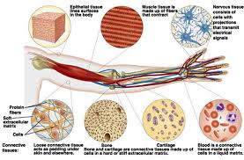
Example
Some examples of this could be the fact that the cells from your left arm are different from the cells in your liver, which are different from the cells in your lungs, which are different from the cells in your hair.

